Slide 1
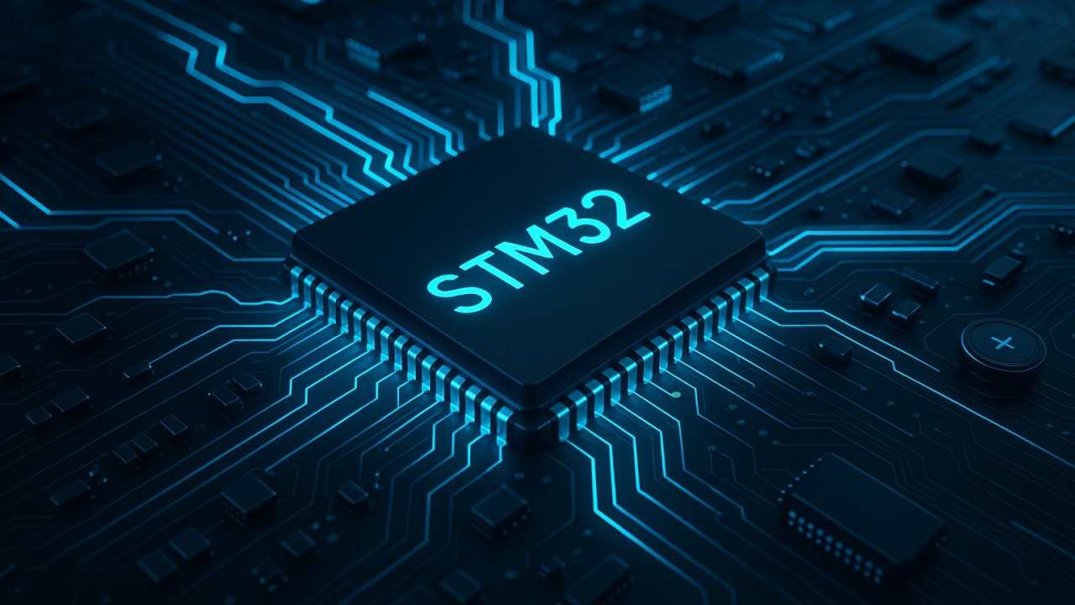


Slide 2
Introduction
It is 32-bit ARM Cortex-M based microcontroller family by STMicroelectronics
Performance
Low power consumption
Rich peripherals
Advanced security
Wireless connectivity

Slide 3
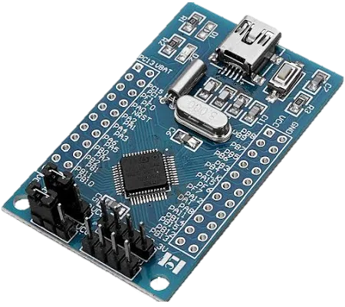
STM32 Core Families
Cortex-M0/M0+
Cortex-M3
Cortex-M4
Cortex-M7
Cortex-M33/M55
STM32F0

Slide 4
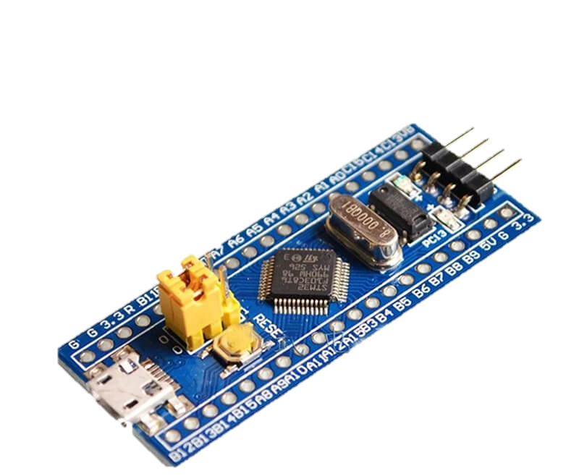
STM32 Core Families
Cortex-M0/M0+
Cortex-M3
Cortex-M4
Cortex-M7
Cortex-M33/M55
STM32F1

Slide 5
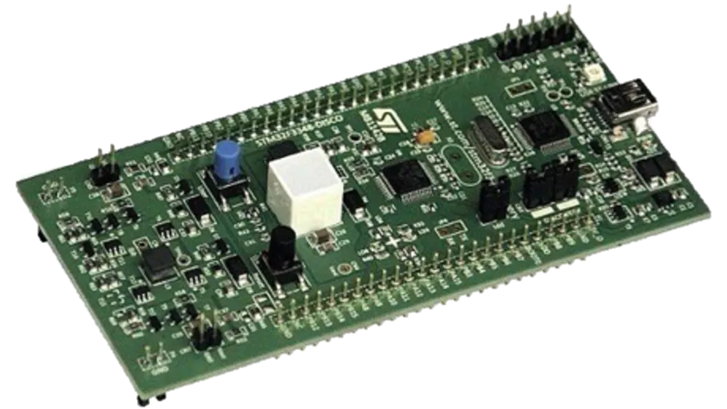
STM32 Core Families
Cortex-M0/M0+
Cortex-M3
Cortex-M4
Cortex-M7
Cortex-M33/M55
STM32F3

Slide 6
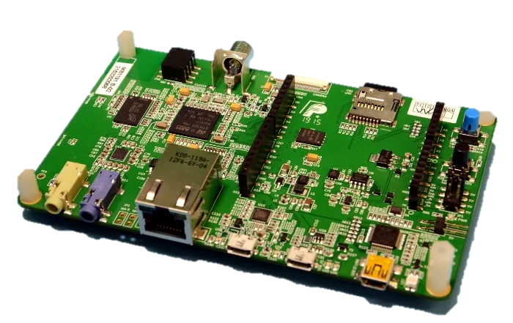
STM32 Core Families
Cortex-M0/M0+
Cortex-M3
Cortex-M4
Cortex-M7
Cortex-M33/M55
STM32F7

Slide 7
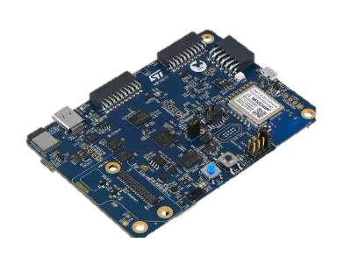
STM32 Core Families
Cortex-M0/M0+
Cortex-M3
Cortex-M4
Cortex-M7
Cortex-M33/M55
STM32U5

Slide 8
Block Diagram
STM32 CHIP
CORTEX CORE
BUS MATRIX
FLASH
PERIPHERALS
SRAM
GPIO
USART
I2C
SPI

Slide 9
Core characteristics
32-bit processing
RISC architecture
Power efficiency
Harvard architecture
On-chip components

Slide 10
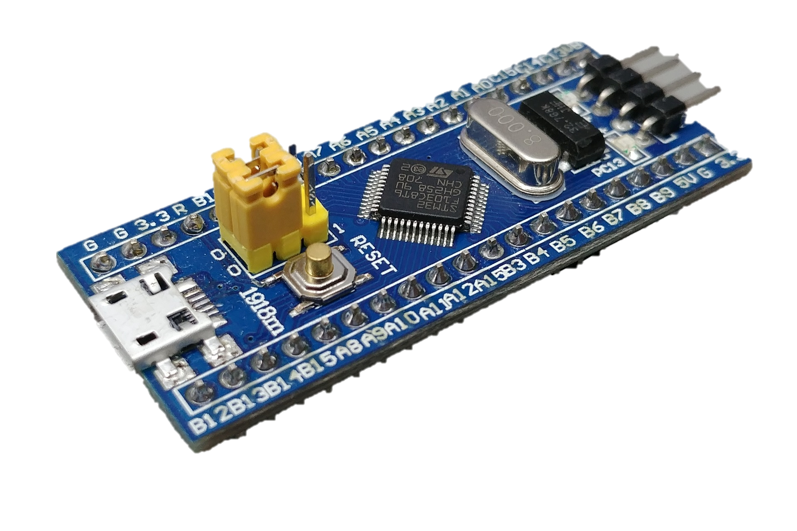
STM32F103C8T6

Slide 11
Specifications
Feature | STM32F103C8T6
FLASH (ROM) | 64kB/128kB
SRAM | 20kB
UART | 3
SPI | 2
I2C | 2
Timers | 7
Clock Speed | 72MHz

Slide 12
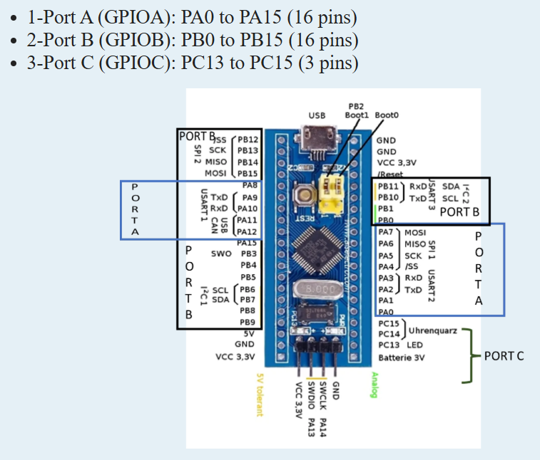
GPIO Pin Information:
The STM32F103C8T6 microcontroller has 37 GPIO pins available, organized into 3 ports:
1-Port A (GPIO): PA0 to PA15 (16 pins)
2-Port B (GPIOB): PB0 to PB15 (16 pins)
3-Port C (GPIOC): PC13 to PC15 (3 pins)

Slide 13
GPIO Pin
PINS | Description
PA0-PA15 | ADCI(Analog to Digital Converter) Inputs
PB0,PB1 | Additional Analog inputs
PA9(TX) | USART 1
PA10(RX)
PA2(TX) | USART 2
PA3(RX)
PB10(TX) | USART 3
PB11(RX)

Slide 14
PINS | Description
PA4(CS) | SPI 1
PA5(SCK)
PA6(MISO)
PA7(MOSI)
PB12(CS) | SPI 2
PB13(SCK)
PB14(MISO)
PB15(MOSI)

Slide 15
PINS | Description
PB6(SCL) | I2C 1
PB7(SDA)
PB10(SCL) | I2C 2
PB11(SDA)
SWDIO | Serial Wire debug input/output
SWCLK | Serial Wire Clock

Slide 16
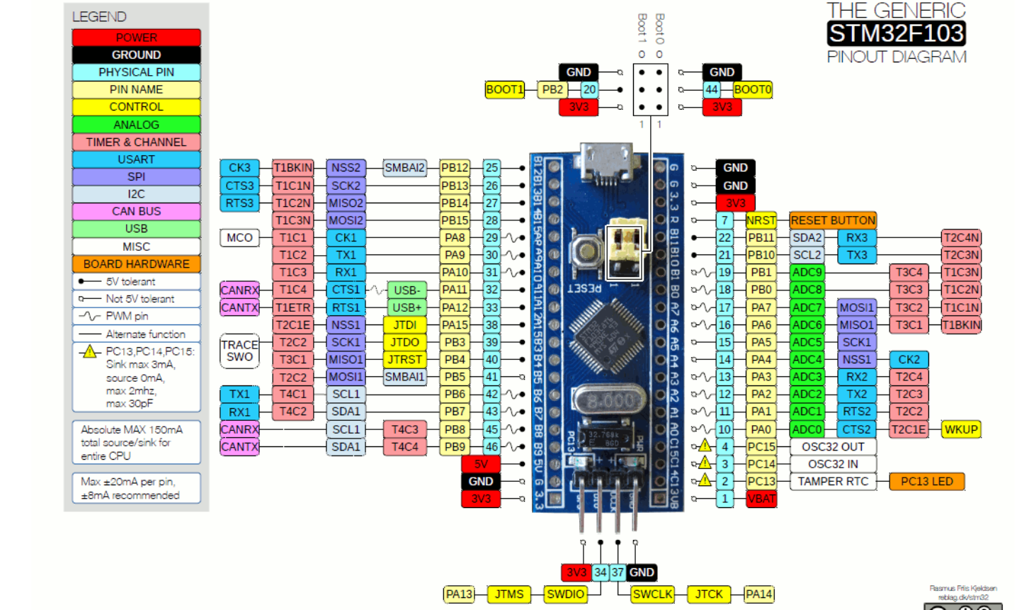
Blue Pill Pinout Diagram (STM32F103)

Slide 17
Core CPU registers include
Registers | Description
R0-R12 | General-purpose registers
R13 | Stack Pointer
R14 | Link Register
R15 | Program Counter
xPSR | Program Status Register

Slide 18
Applications:
Consumer Electronics
Industrial Automation
Robotics
Communication devices

Slide 19
THANK YOU

